Slide 1
Key Macroeconomic Imbalances in the case of BH
Antonio Musa, CBBH
Sarajevo, November 7th 2019
CBBH Conference „Macroeconomic Imbalances and EU Convergence “

Slide 2
Summary
Economic growth continued in Bosnia and Herzegovina at moderate rates of around 3% per year, which are not sufficient for faster convergence, given that BH reaches only 31% of the average EU development level.
The current model of slow convergence depends on the continued growth of the most important trading partners and on extremely low interest rates.
The current account deficit of BH and the net international investment position go beyond what is defined as sustainable by indicators of EU macroeconomic imbalances.
In BH, the private sector is not over-indebted and there are no indicators of internal imbalances. The gross debt of the general government sector is well below the 60% GDP.

Slide 3
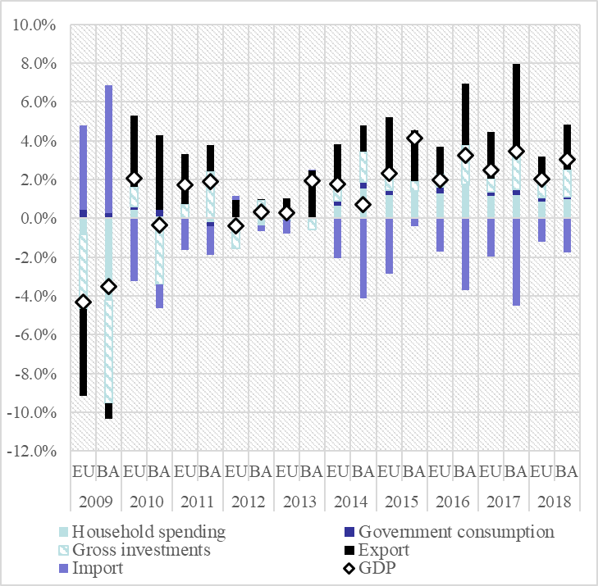
Macroeconomic Outlook
Economic activity in BH record steady growth rates in recent years because of the positive contribution of household consumption, gross investment and exports.
Unemployment rate is still extremely high, as a result of insufficient economic growth and informal economy.
High structural unemployment rates, negative demographic trends and low participation rates limit the potential growth of the economy in the long run.
Source: BHAS, EUROSTAT.

Slide 4
MIP Scoreboard Indicators - 2018
2018 | External imbalances and competitiveness |  |  |  |  | Internal imbalances |  |  |  |  |  | Employment indicators
 | Current account balance - % of GDP (3 year average) | Net international investment position (% of GDP) | Real effective exchange rate, HICP deflator (3 year % change) | Export market share - % of world exports(5 year % change) | Nominal unit labour cost index (2010=100)(3 year % change) | House price index (2015=100), deflated (1 year % change) | Private sector credit flow, consolidated (% of GDP) | Private sector debt, consolidated (% of GDP) | General government gross debt (% of GDP) | Unemployment rate (3 year average) | Total financial sector liabilities, non-consolidated(1 year % change) | Activity rate - % of total population aged 15-64(3 year change in pp) | Long-term unemployment rate - % of active population aged 15-74(3 year change in pp) | Youth unemployment rate - % of active population aged 15-24(3 year change in pp)
Thresholds | From -4 % to 6 % | -35% | ±5 % (euroarea) ±11 % ( non euroarea) | -6% | 9 % (euroarea) 12 % (non euroarea) | 6% | 14% | 133% | 60% | 10.0% | 16.50% | (- 0,2 pp) | 0,5 pp | 2,0 pp
Bosnia and Herzegovina | -4.5 | -44.6 | -1.1 | 0.0 | 2.0 | 1.6 | 0.7 | 59.6 | 34.7 | 21.4 | 4.5 | -4.5 | 0.7 | -37.7
Belgium | -0.4 | 43.9 | 6.9 | 2.8 | 3.5 | 1.1 | 0.9 | 182.2 | 102.0 | 7.0 | -2.9 | 1.0 | -1.5 | -6.3
Bulgaria | 3.4 | -36.8 | 4.1 | 10.5 | 13.5 | 3.9 | 4.0 | 96.5 | 22.6 | 6.3 | 6.7 | 2.2 | -2.6 | -8.9
Czechia | 1.2 | -23.5 | 11.0 | 12.1 | 13.5 | 6.1 | 5.3 | 70.7 | 32.7 | 3.0 | 7.4 | 2.6 | -1.7 | -5.9
Denmark | 7.2 | 63.1 | 2.5 | -4.4 | 4.0 | 3.5 | 2.4 | 199.4 | 34.1 | 5.6 | -4.7 | 0.9 | -0.6 | -1.5
Germany | 7.9 | 61.0 | 5.3 | 3.3 | 5.6 | 5.1 | 6.6 | 102.4 | 60.9 | 3.8 | 2.0 | 1.0 | -0.6 | -1.0
Estonia | 2.3 | -28.2 | 7.6 | 1.3 | 14.3 | 2.1 | 3.7 | 101.5 | 8.4 | 6.0 | 6.9 | 2.4 | -1.1 | -1.2
Ireland | 2.4 | -167.9 | 2.3 | 77.7 | -2.8 | 8.3 | -7.8 | 223.2 | 64.8 | 7.0 | 5.1 | 0.8 | -3.2 | -6.4
Greece | -2.1 | -138.4 | 3.9 | 5.7 | 1.4 | 1.3 | -1.1 | 115.3 | 181.1 | 21.5 | -5.0 | 0.4 | -4.6 | -9.9
Spain | 1.7 | -77.1 | 4.1 | 4.5 | 0.3 | 5.3 | 0.4 | 133.8 | 97.1 | 17.4 | -2.5 | -0.6 | -5.0 | -14.0
France | -0.6 | -16.4 | 4.5 | 0.0 | 2.4 | 1.5 | 7.9 | 148.9 | 98.4 | 9.5 | 1.6 | 0.6 | -0.8 | -4.0
Croatia | 3.0 | -54.1 | 4.1 | 18.5 | -2.2 | 4.8 | 2.3 | 94.2 | 74.6 | 10.9 | 4.5 | -0.6 | -6.8 | -18.6
Italy | 2.5 | -3.9 | 3.4 | 0.6 | 2.7 | -1.6 | 1.6 | 107.0 | 132.2 | 11.2 | -0.1 | 1.6 | -0.7 | -8.1
Cyprus | -6.8 | -114.7 | 1.5 | 5.6 | -0.5 | 0.2 | 8.1 | 288.1 | 102.5 | 10.8 | -2.0 | 1.1 | -4.1 | -12.6
Latvia | 0.5 | -49.1 | 4.9 | 5.9 | 14.7 | 6.6 | -0.2 | 70.3 | 35.9 | 8.6 | -3.0 | 2.0 | -1.4 | -4.1
Lithuania | 0.6 | -29.5 | 6.2 | 6.0 | 16.5 | 4.8 | 4.3 | 56.4 | 34.2 | 7.1 | 8.2 | 3.2 | -1.9 | -5.2
Luxembourg | 4.9 | 45.6 | 3.3 | 10.4 | 7.9 | 5.2 | -0.5 | 306.5 | 21.4 | 5.8 | -2.0 | 0.2 | -0.5 | -2.8
Hungary | 3.1 | -46.8 | 2.0 | 9.2 | 12.4 | 10.8 | 4.3 | 69.3 | 70.8 | 4.3 | -9.2 | 3.3 | -1.7 | -7.1
Malta | 8.0 | 63.3 | 4.8 | 24.1 | 3.2 | 5.1 | : | : | 46.0 | 4.1 | : | 5.4 | -1.3 | -2.4
Netherlands | 9.9 | 70.7 | 3.2 | 1.9 | 3.0 | 7.4 | 4.5 | 241.6 | 52.4 | 4.9 | -3.3 | 0.7 | -1.6 | -4.1
Austria | 2.3 | 3.8 | 4.9 | 4.0 | 3.8 | 2.6 | 3.9 | 121.0 | 73.8 | 5.5 | 1.7 | 1.3 | -0.3 | -1.2
Poland | -0.3 | -56.2 | 0.1 | 25.4 | 7.8 | 4.8 | 3.3 | 76.1 | 48.9 | 5.0 | 2.9 | 2.0 | -2.0 | -9.1
Portugal | 0.1 | -100.8 | 3.2 | 8.6 | 5.8 | 9.0 | -0.1 | 154.3 | 121.5 | 9.1 | 0.7 | 1.7 | -4.1 | -11.7
Romania | -3.3 | -44.5 | -0.6 | 23.1 | 33.6 | 1.8 | 1.9 | 47.8 | 35.0 | 5.0 | 3.3 | 1.7 | -1.2 | -5.5
Slovenia | 5.5 | -18.9 | 2.0 | 20.7 | 6.1 | 7.4 | 1.3 | 72.8 | 70.1 | 6.6 | 4.1 | 3.2 | -2.5 | -7.5
Slovakia | -2.2 | -67.3 | 2.4 | 3.8 | 9.1 | 5.0 | 1.9 | 90.4 | 48.9 | 8.1 | 8.9 | 1.5 | -3.6 | -11.6
Finland | -1.0 | -0.4 | 2.9 | -3.9 | -2.4 | -0.1 | 1.6 | 142.0 | 58.9 | 8.3 | 19.9 | 2.1 | -0.7 | -5.4
Sweden | 2.8 | 8.0 | -3.9 | -6.1 | 7.0 | -3.0 | 9.0 | 200.0 | 38.8 | 6.6 | -2.9 | 1.2 | -0.3 | -3.6
United Kingdom | -4.1 | -6.7 | -13.0 | -2.9 | 7.4 | 0.9 | 5.3 | 170.9 | 86.8 | 4.4 | -0.6 | 1.0 | -0.5 | -3.3
Source: European Commission, CBBH, BHAS.

Slide 5
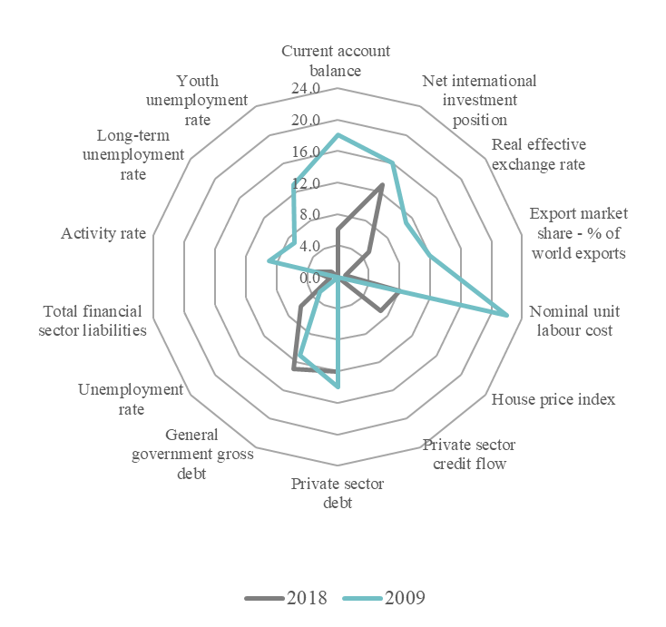
MIP indicators
After the economic crisis it was found that inadequate management of other economic policies led to significant external and internal imbalances, loss of competitiveness, and excessive distortions in the labor market.
In recent years, imbalances have emerged regarding real estate price developments and nominal unit labor costs, suggesting a mismatch between wage growth and labor productivity growth.
Source: European Commission

Slide 6
MIP Indicators for Bosnia and Herzegovina
Bosnia&Herzegovina | Indicators | Thresholds | 2013 | 2014 | 2015 | 2016 | 2017 | 2018
External imbalances and competitiveness | Current account balance - % of GDP (3 year average) | From -4 % to 6 % | -7.8% | -7.1% | -6.0% | -5.8% | -4.9% | -4.5%
 | Net international investment position (% of GDP) | -35.0% | -56.7% | -56.8% | -54.9% | -52.1% | -47.9% | -44.6%
 | Real effective exchange rate, HICP deflator (3 year % change) | ±5 % (EA) ±11 % ( non-EA) | -1.7% | -2.8% | -4.8% | -4.6% | -4.4% | -1.1%
 | Export market share - % of world exports(5 year % change) | -6,0% | 0.0% | 0.0% | 0.0% | 0.0% | 50.0% | 0.0%
 | Nominal unit labor cost index (2010=100)(3 year % change) | 9 % (EA) 12 % (non-EA) | 4.3% | 1.7% | -0.7% | -1.1% | -1.8% | 2.0%
Internal imbalances | House price index (2015=100), deflated (1 year % change) | 6,0% | -1.7% | -3.6% | 2.2% | 2.0% | 2.9% | 1.6%
 | Private sector credit flow, consolidated (% of GDP) | 14.0% | -0.3% | -0.7% | -1.6% | -0.9% | 0.8% | 0.7%
 | Private sector debt, consolidated (% of GDP) | 133.0% | 61.2% | 60.5% | 58.9% | 58.0% | 58.8% | 59.6%
 | General government gross debt (% of GDP) | 60.0% | 37.6% | 41.5% | 41.9% | 45.1% | 36.0% | 34.7%
 | Unemployment rate (3 year average) | 10.0% | 27.7% | 27.7% | 27.6% | 26.9% | 24.5% | 21.4%
 | Total financial sector liabilities, non-consolidated(1 year % change) | 16.5% | 4.8% | 5.2% | 4.6% | 5.5% | 8.3% | 9.1%
Employment indicators | Activity rate - % of total population aged 15-64(3 year change in pp) | (- 0.2 pp) | -2.2% | -0.7% | 0.2% | -1.1% | -2.5% | -4.5%
 | Long-term unemployment rate - % of active population aged 15-74(3 year change in pp) | 0.5 pp | 0.9% | 5.0% | -0.1% | 2.9% | -3.2% | 0.7%
 | Youth unemployment rate - % of active population aged 15-24(3 year change in pp) | 2.0 pp | 2.8% | 8.3% | -1.3% | -8.1% | -27.0% | -37.7%
Source: CBBH, BHAS

Slide 7
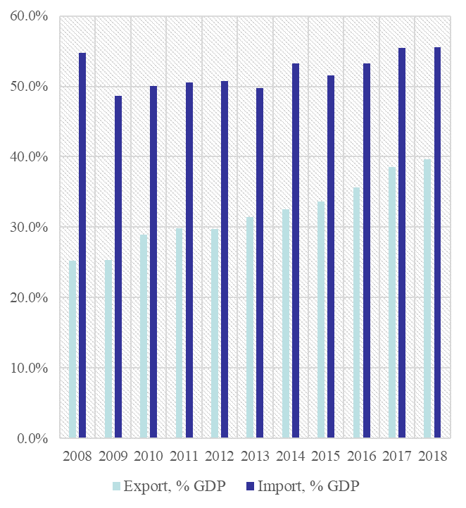
External Sector
The slowdown in our main trading partners have a negative impact on exports.
The high correlation in the movement of industrial production indicates the coherence of the BH business cycle with our main trading partners, which exposes our country to external shocks and spillover effect.
Predicted extension of expansionary monetary policy contributes to eased financing of chronic current account deficits.
Source: CBBH

Slide 8
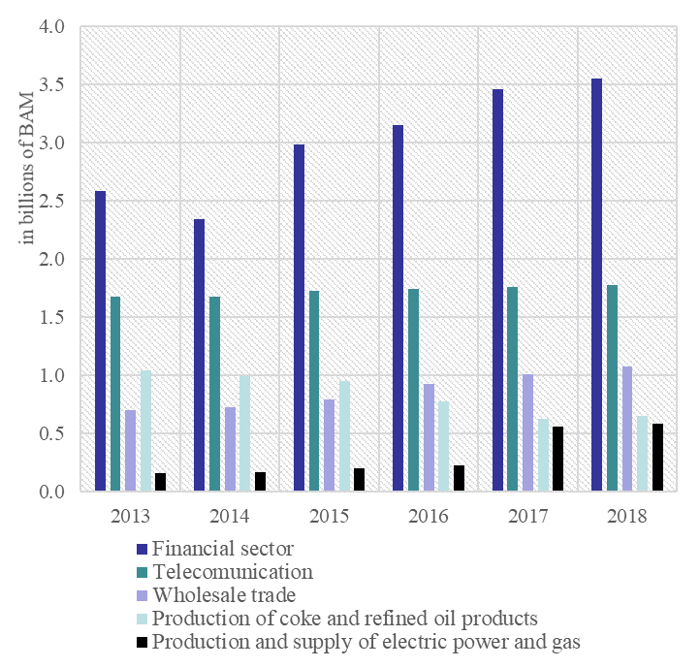
Structure of FDI
The structure of foreign direct investment by investment area is unfavorable in the long run.
Foreign direct investment, as a form of stable borrowing and financing of the current account deficit, should be more significant in the future, as BH is ranked last in the region.
The International Investment Position has improved significantly over the last two years and stands at -44.6% of GDP in 2018.
Source: CBBH

Slide 9
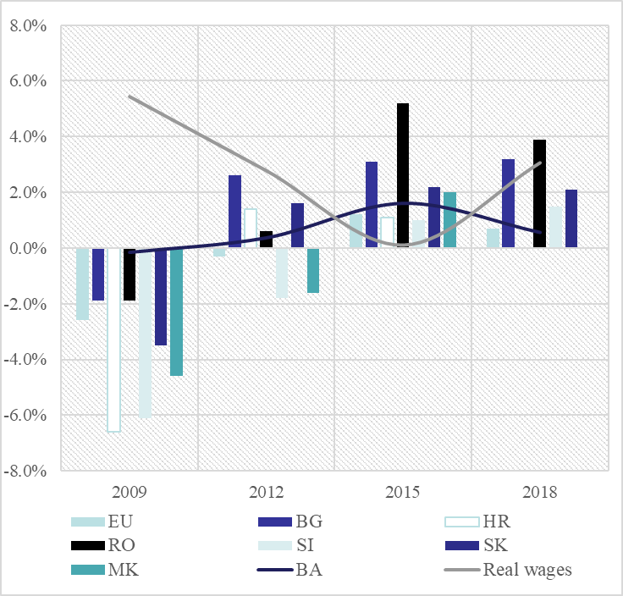
Competitiveness
International competitiveness indices indicate insufficient progress, which is particularly pronounced for the categories: information and communication technologies, public institutions, and the capacity for innovation.
The stagnation of competitiveness due to the lower contribution of productivity growth and a slight increase in unit labor costs.
Source: BHAS, EUROSTAT, own calculations

Slide 10
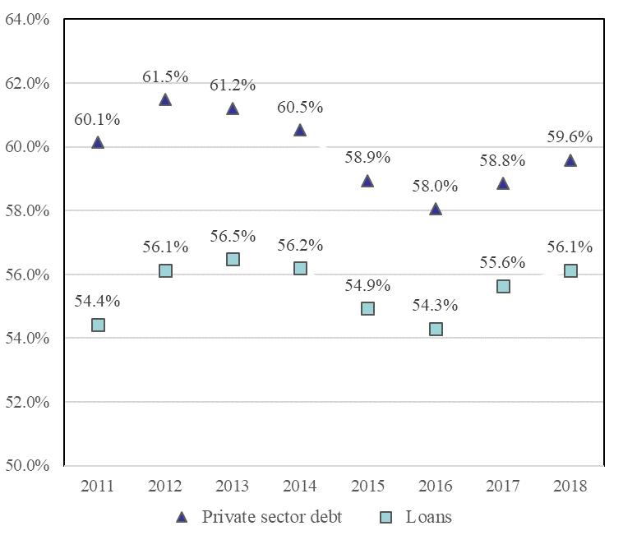
Private debt
As an indicator of macroeconomic imbalance, the level of private debt as a percentage of GDP cannot be assessed as excessive in BH.
Interest rates on loans in BH are at a historically low level.
Still, interest rates are significantly higher than in the euro area, largely due to the risk premium reflecting the overall macroeconomic situation in the country.
Source: CBBH, BHAS

Slide 11
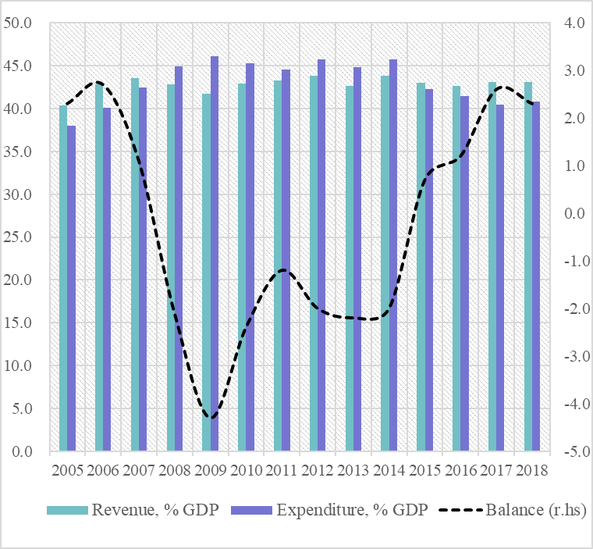
Fiscal sector
The dominance of wages and social benefits in the structure of public spending (70% of total spending) leaves little room for capital investment.
Although the opportunities for higher growth of taxes are much exhausted, suppressing the informal economy could increase the room for revenue growth on this basis.
Source: CBBH, BHAS

Slide 12
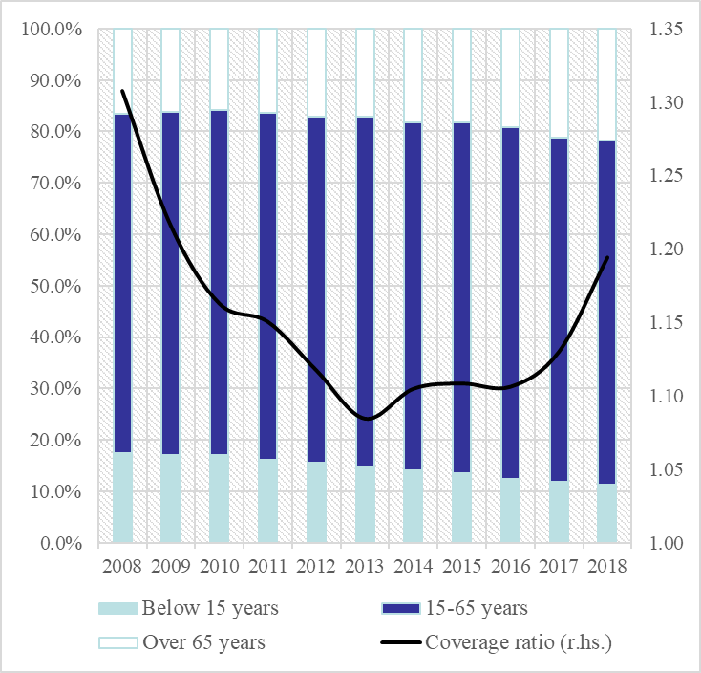
Labor market - Priority reforms
The ageing group above 65 years’ old is higher by 5.9% from 2010 through 2018. Considering the population below 15 year old, for the same period, their share in the overall population is lower by 5.7%.
Progress towards addressing the important challenges related to long-term sustainability of public finances is slow.
The effect of labor on potential growth will diminish due to population aging and emigration.
Source: CBBH, BHAS

Slide 13
Labor market - Priority reforms
As part of the Euro 2020 Strategy, one of the headline targets is to increase employment rate of the population aged 20-64 to at least 75%.
Considering the BH, the share of inactive population is substantially higher than in the EU countries.
Education and pension reform could have a positive impact on increasing labor use, while contending the informal economy, and improving public sector governance, could significantly increase competitiveness.

Slide 14
Concluding remarks
Harmful macroeconomic imbalances can adversely affect economic stability in a particular Member State, or the EU as a whole. This is why their timely and effective correction is so important.
BH is experiencing imbalances, especially for employment indicators, which indicates unfavorable allocation of resources and under-adjustment of the economy.
An inflexible labor market, with a high share of public sector employment and a neglected reform of the education system, burden competitiveness in the market and represent the most important source of macroeconomic imbalances.
There is increasing role of structural reforms in helping achieve stronger and durable potential growth.

Slide 15
Thank you for your attention.

